Slide 1
Automatic Labelling of YouTube Videos
CSE 847: Final Project Presentation
Cooking?
Musician?
Animal?
Video Game?
Bollywood?
Gymnastics?
Vehicle?
Fashion?
Rahul Dey Tarang Chugh
April 26, 2017

Slide 2
Problem Statement
Automatically assign labels to multimedia data using video and audio features.
Indexing/Searching
Law Enforcement
Exponential Growth

Slide 3
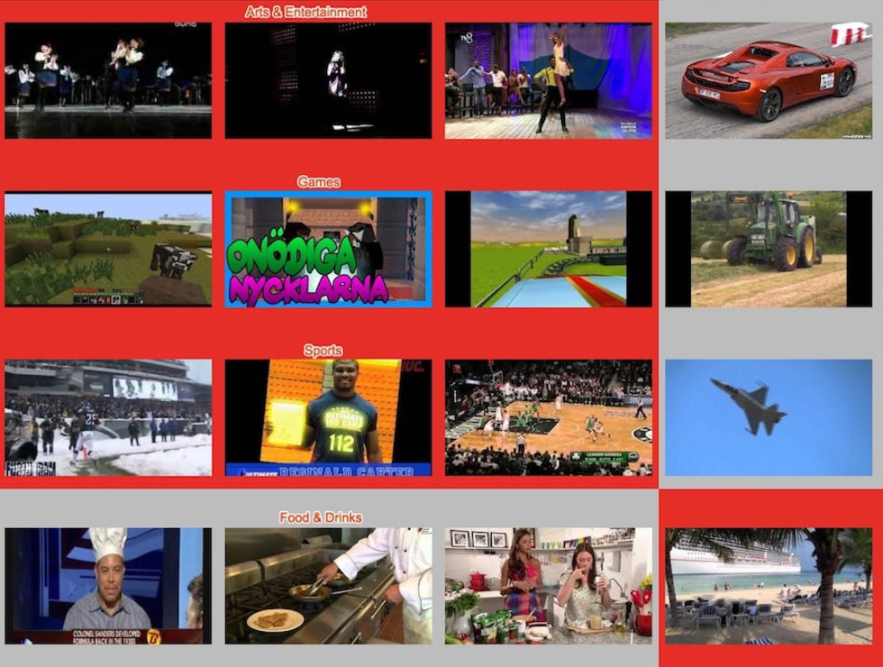
Dataset
YouTube Dataset
8 Million videos with multiple labels
4716 classes
3.4 avg. labels/video
Train | Validate | Test | Total
5,786,881 | 1,652,167 | 825,602 | 8,264,650
Features
Video-level & Frame-level (sampled at 1fps)
Utilized Inception-v3 network pre-trained on ImageNet Dataset
Video representation extracted from penultimate layer : 2048D
PCA (+ whitening): 1024D video, 128D audio
https://research.google.com/youtube8m/workshop.html
Abu-El-Haija, Sami, et al. "Youtube-8m: A large-scale video classification benchmark." arXiv preprint arXiv:1609.08675 (2016).

Slide 4
Proposed Approach
Logistic Regression
Deep Bag of Frames (DBoF)
LSTM
Ensemble?
Neural Network

Slide 5
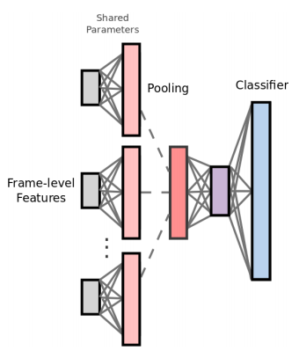
Deep bag of frames (dbOf) model
Frame level features projected onto higher dimensional features using shared parameters
RELU activation along with learned parameters produce sparse features
Max-pooling of frame level features to video level features
Logistic Regression on video level features

Slide 6
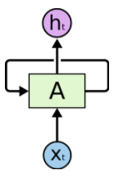
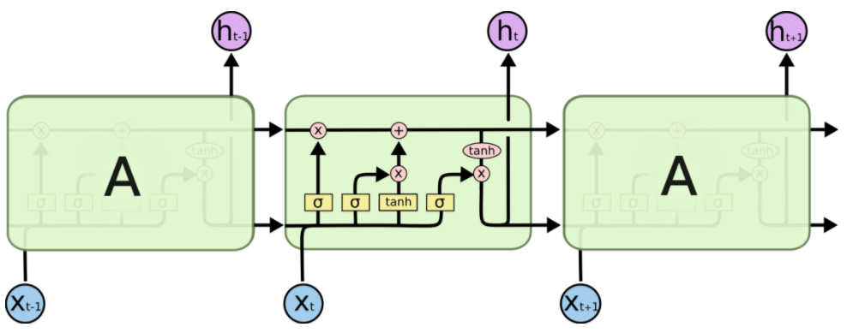
Long short term memory (lstm)
RNN
LSTM

Slide 7
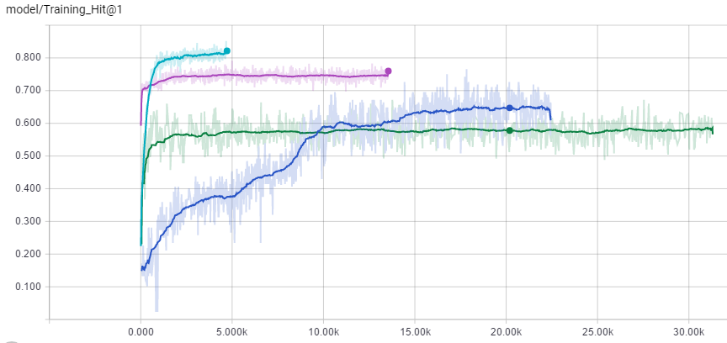
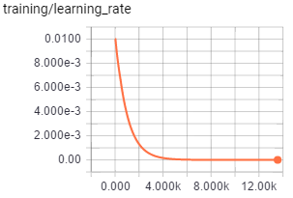
Training on frame level features accuracies
Logistic
LSTM
Neural Network
DBoF

Slide 8
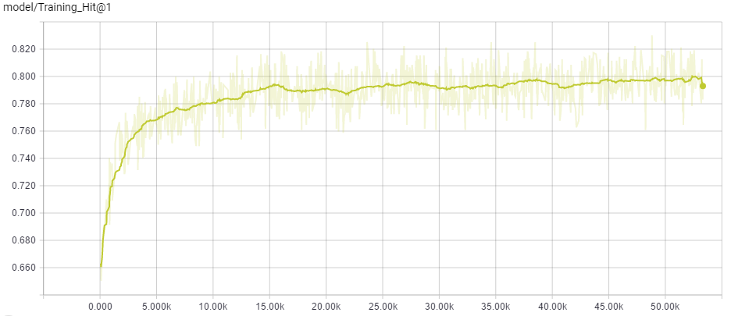
Training on video level features
Logistic Regression

Slide 9
Kaggle submissions
Model | Classifier | Score
1 | DBoF | 72.72%
2 | Logistic Regression | 61.30%
3 | Neural Networks | 34.00%
4 | LSTM
5 | Ensemble (1 + 2 + 3) | 55.33%
6 | Ensemble (1 + 2) | 62.47%

Slide 10

Example video
Ground Truth
Soldier
Weapon
Outdoor Recreation

Slide 11
Our predictions
Neural Network |  | LSTM |  | Logistic Regression |  | DBoF Model
Game | 0.7246 | Game | 0.9563 | Outdoor Recreation | 0.3102 | Outdoor Recreation | 0.7855
Weapon | 0.4244 | Video Game | 0.8907 | Hunting | 0.2612 | Soldier | 0.4930
Vehicle | 0.3542 | Weapon | 0.6840 | Weapon | 0.2584 | Weapon | 0.4264
Video Game | 0.3054 | Call of Duty | 0.4652 | Soldier | 0.2197 | Hunting | 0.3170
Call of Duty | 0.1965 | PC Game | 0.3424 | Nature | 0.1492 | Forest | 0.2022

Slide 12
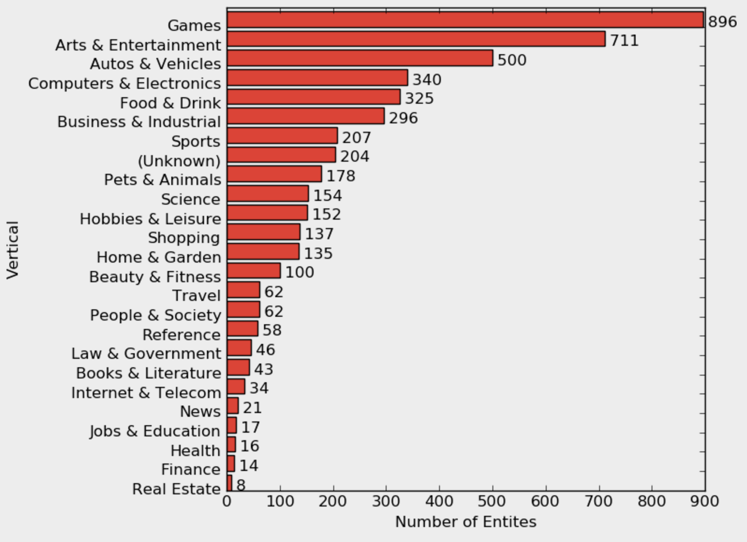
Post Processing using Domain Knowledge
4715 classes belonging to 25 top-level verticals
Unlikely to have labels from Games with labels from Finance
F1
G1
G2
O1
G3
F2
0.37
0.34
0.18
0.05
0.03
0.03
0.55
0.40
0.05
G1
F1
G2
G3
F2
0.40
0.32
0.21
0.04
0.02
0.01
https://research.google.com/youtube8m/index.html

Slide 13
Conclusions and future work
Well representative features (PCM on Inception)
LSTM suffering from lack of sequential information needed for video labelling
A simple Logistic Regression over features extracted by Inception performs quite well to give a prediction rate of 61.30 %.
Bootstrapping/Bagging followed by Ensemble of multiple classifiers such as Logistic Regression, SVM, DBoF, LSTM/GRU, etc.
Post processing using Domain Knowledge

Slide 14
Thank You

